Slide 1
Modelling diffusion of syntactic innovations: Geospatial models, S-curves and the Constant Rate Hypothesis
David Willis
Department of Theoretical and Applied Linguistics
University of Cambridge
dwew2@cam.ac.uk

Slide 2
S-curves
sto vol’tov ‘100 volts’ > sto vol’t

Slide 3
S-curve model: slope, s (rate of change), k = 0

Slide 4
S-curve: intercept, k (timing of innovation), s = 0.05

Slide 5
S-curve model: logit transformation, k = 0

Slide 6
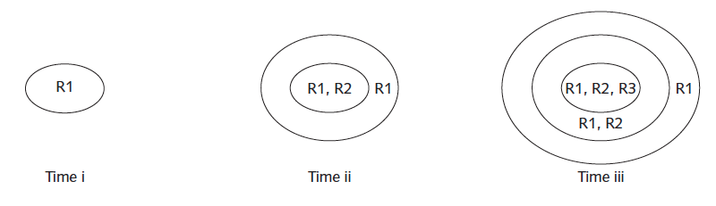
Wave model
Wave model of linguistic (contagion) diffusion (Wolfram &
Schilling-Estes 2003)

Slide 7
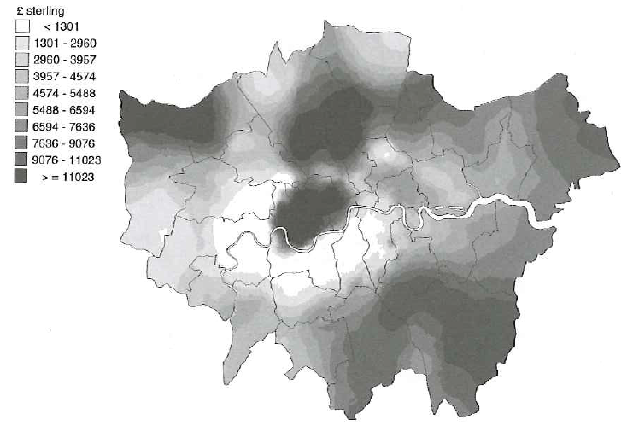
Geographically Weighted Regression
Additional value to London property of having garage facilities, 1991 (Fotheringham, Brunsdon and Charlton 2002: 49)

Slide 8
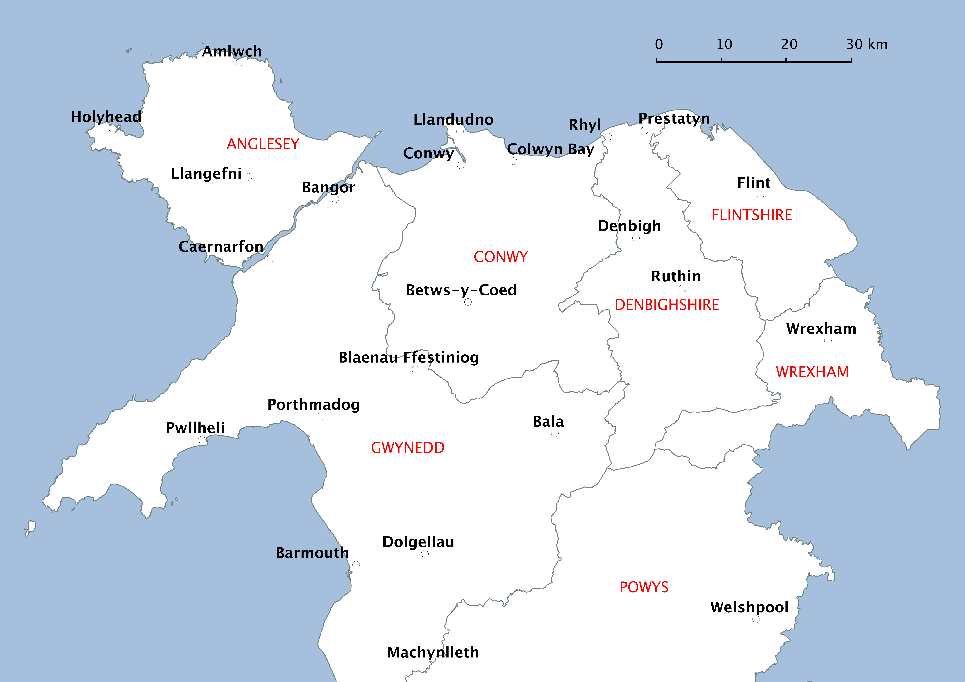

Slide 9
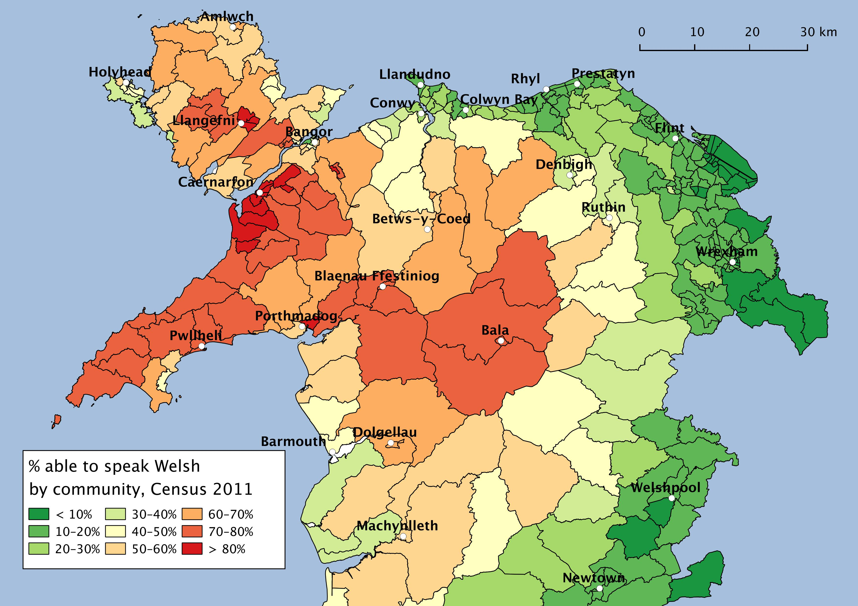

Slide 10
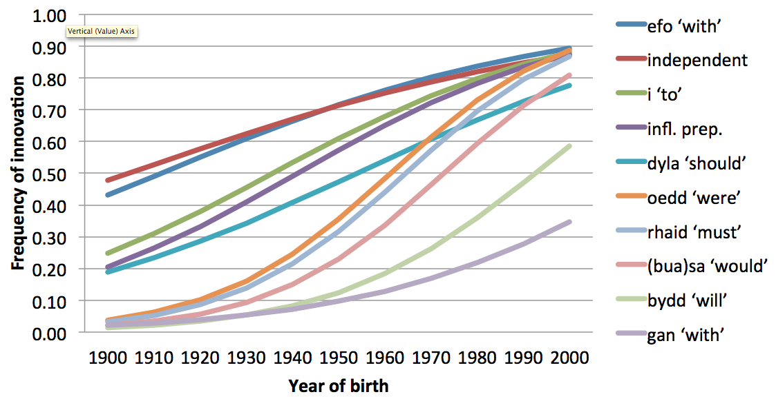
Global model

Slide 11
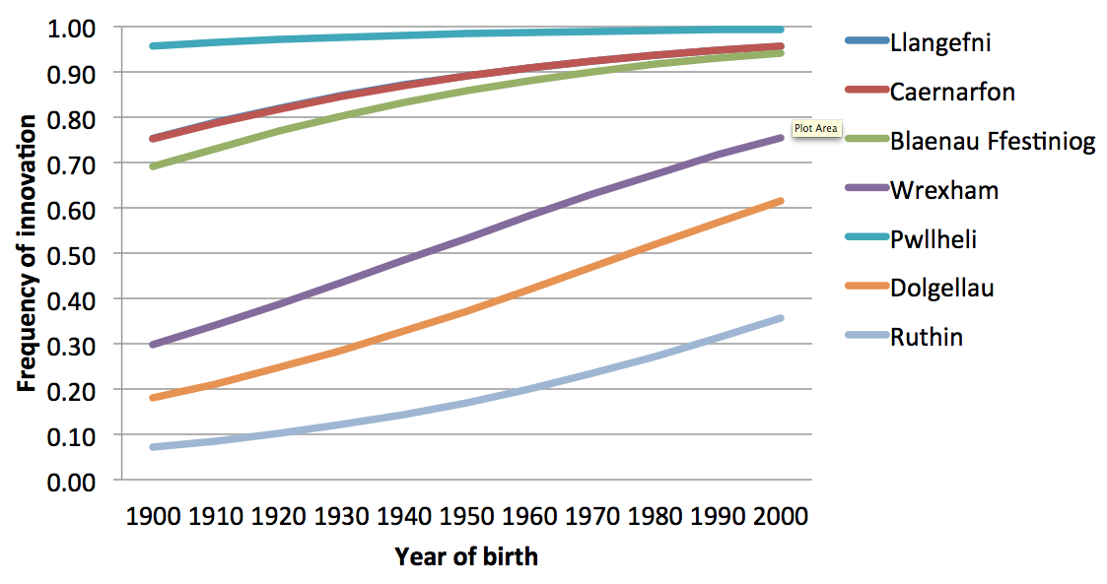
Geographically-weighted model by location (efo chdi ‘with you’)

Slide 13
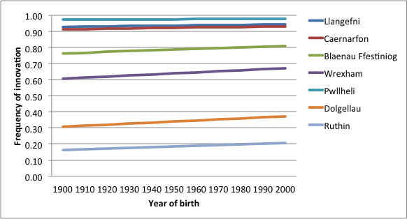
Geographically-weighted model by location (independent chdi)

Slide 15
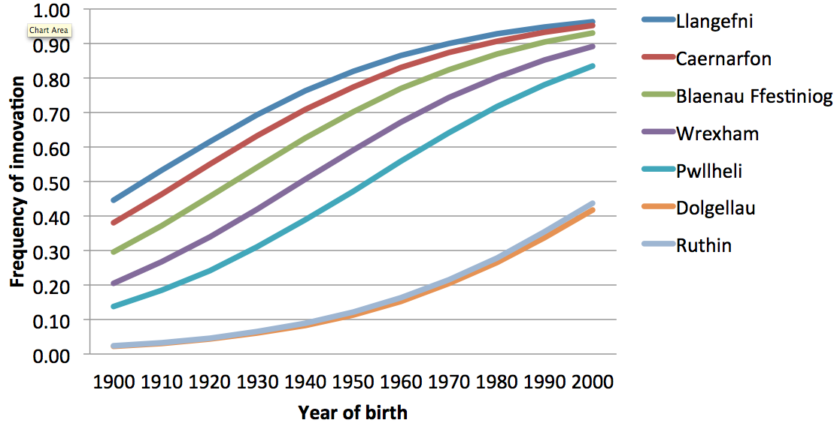
Geographically-weighted model by location (i chdi ‘to you’)

Slide 19
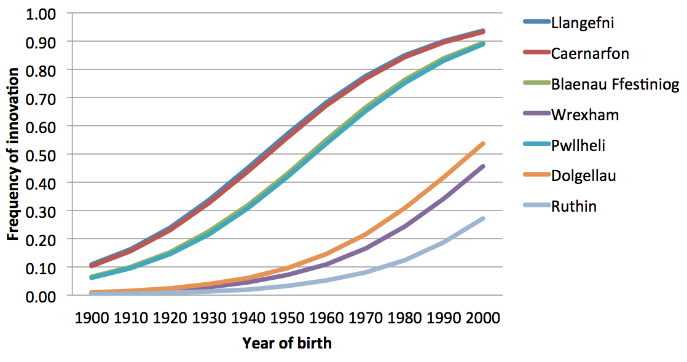
Geographically-weighted model by location (oedda chdi ‘you were’)

Slide 24
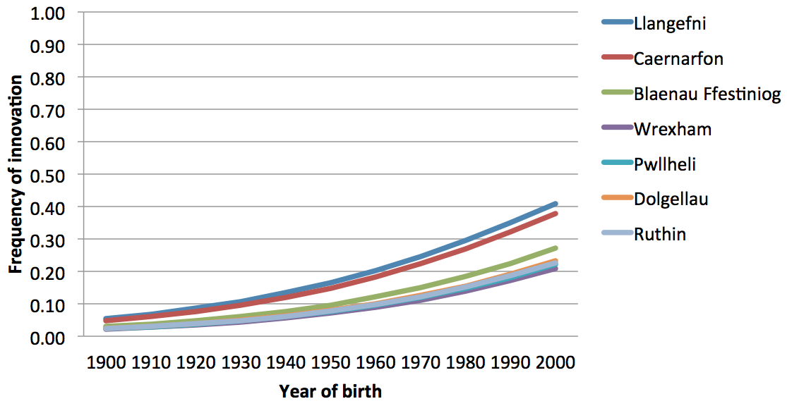
Geographically-weighted model by location (gynno chdi ‘with you’)

